Slide 1
TANZANIAN WATER WELLS
By: Harris Lukundi
Email: harris.lukundi@student.moringa.com

Slide 2
Overview
Tanzania has experienced significant economic growth over the years, however a significant proportion of its population remains without proper access to improved drinking water
The country now faces a difficult task of meeting the Sustainable Development Goals (SDGs) to provide universal coverage of safe water by 2030.
Estimates shows up to 44% failure of their water points which is the failure rate in Africa.

Slide 3
PROBLEM STATEMENT
We have been tasked by World Bank Group together with the Government of Tanzania to seek a better understanding as to why water point failure is significantly higher in Tanzania as opposed to the rest of Africa
Provide a way to reliably predict when water points shall fail as they tackle the difficult task of meeting their 2030 MDG goals in Environmental Sustainability .

Slide 4
OBJECTIVES
1. Analyze the Impact of Age, Technology, and Investment on Water Point Failure
Assess the Impact of Socioeconomic and Geographical Factors
Develop a Predictive Model for Water Point Failure

Slide 5
DATA UNDERSTANDING
The data to be used within this exploratory analysis comes from a competition held by DRIVEN DATA
The results that we sort are categorized into two:
functional: The water point is operational and there are no repairs needed
non functional: The water point is not operational

Slide 6
DATA ANALYSIS APPROACH
Data Mining
Data Cleaning
Data Analysis and Visualization
Modeling and Parameter Tuning
Insights
Recommendations

Slide 7
OBSERVATIONS AND RESULTS

Slide 8
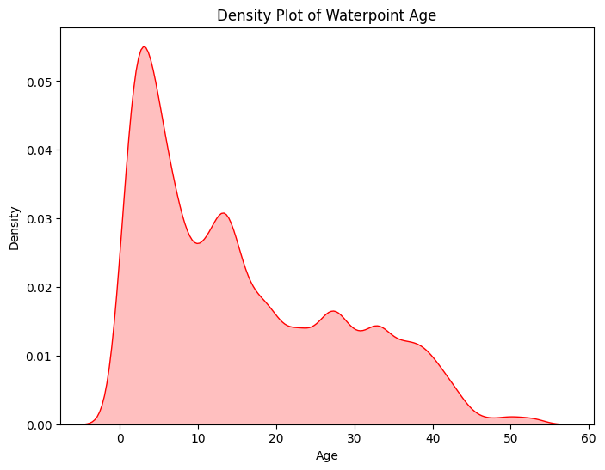
AGE FACTORS
Most Water Points Built in approximately the last 15 years

Slide 9
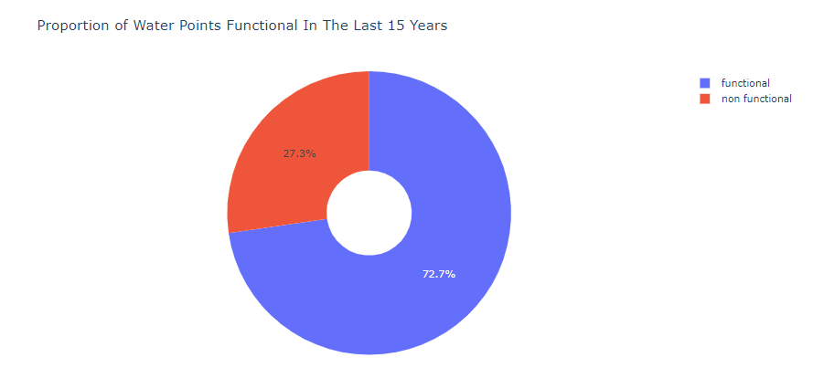
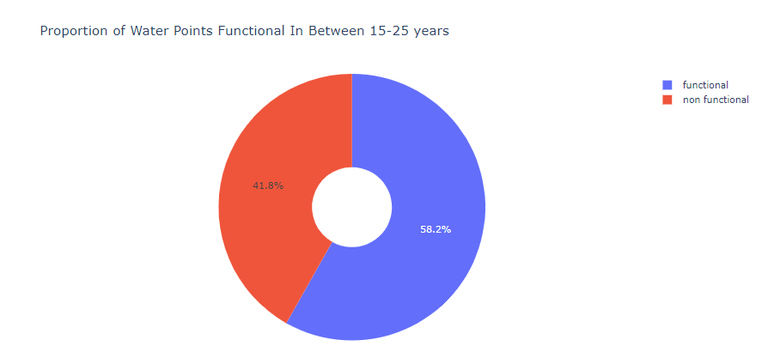

Slide 10
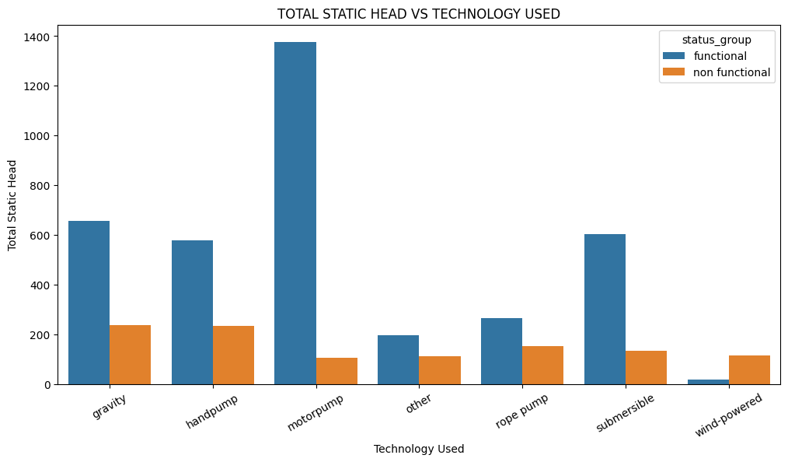
WATER EXTRACTION METHOD WITH HIGHEST WATER RETURN(TSH)

Slide 11
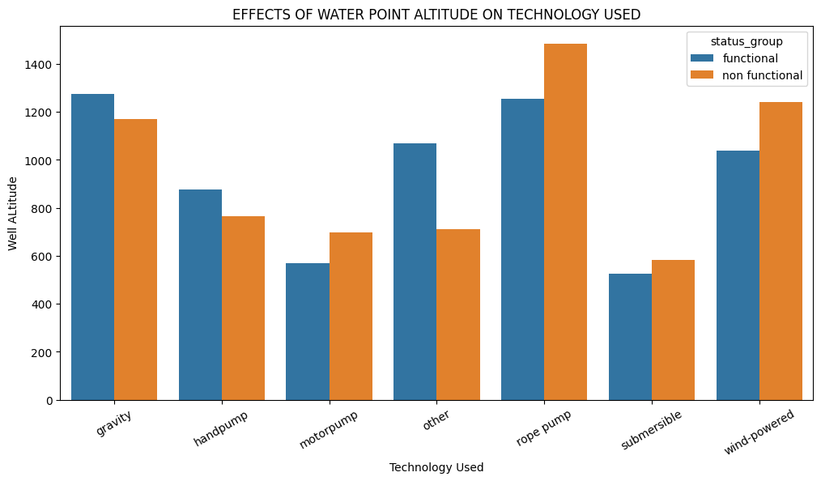
EFFECT OF ALTITUDE ON EXTRACTION METHOD USED

Slide 12
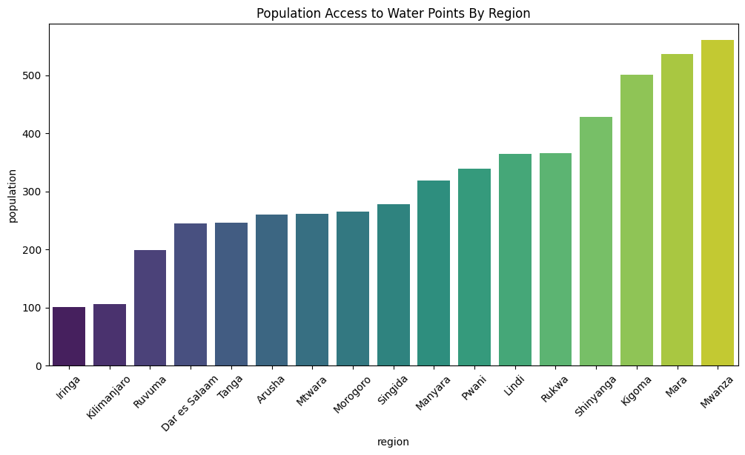

Slide 13
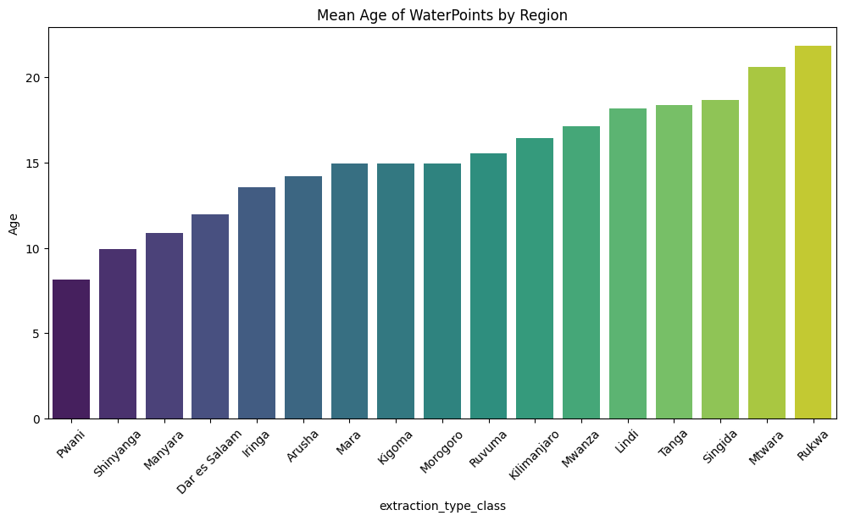

Slide 14
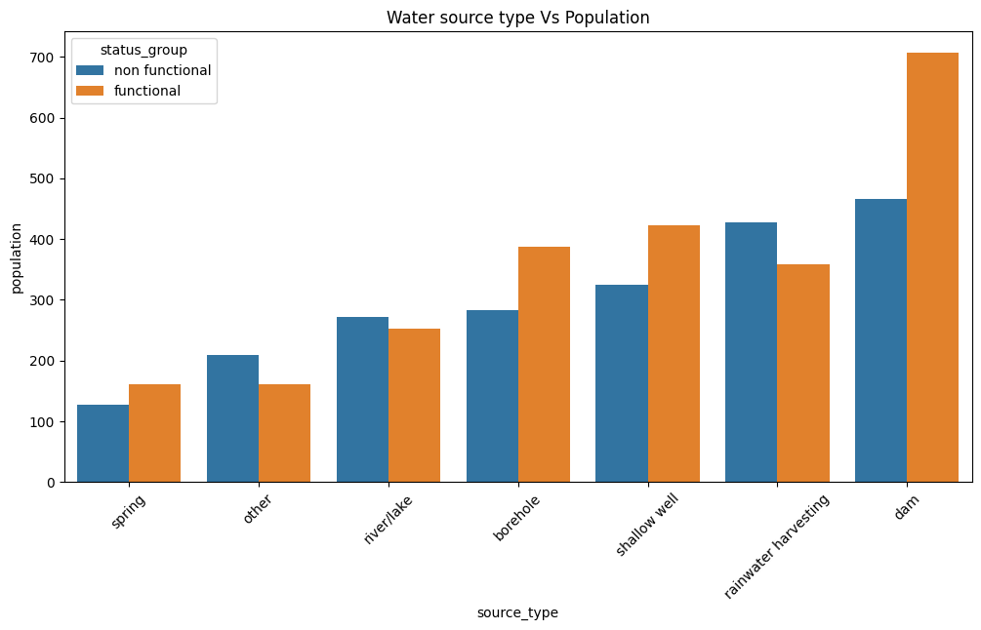

Slide 15
RECOMMENDATIONS
Water Point Pumps require replacement every 10-15 years to ensure failure doesn’t affect the population as well as a premise for predictive maintenance.
Focus needs to be meet in regions such as Lindi, Mwanza, Mara and Rukwa which have high population accessing fewer water points.
Leverage more reliable extraction type technology such as motor pumps which give more water output per water point.
Seek green alternatives e.g. solar powered pumps to reduce reliance on inefficient hand and rope pumps
Using the predictive algorithm, you can predict with up to 80% accuracy to prevent water point downtimes.

Slide 16
NEXT STEPS
New data required as the dataset is missing significant data points and was recorded over 11 years so feature elements might have changed

Slide 17
THANK YOU!
ANY QUESTIONS?
By: Harris M. Lukundi
Email: harris.lukundi@student.moringaschool.com
Tel No: 0707512518

